Slide 1







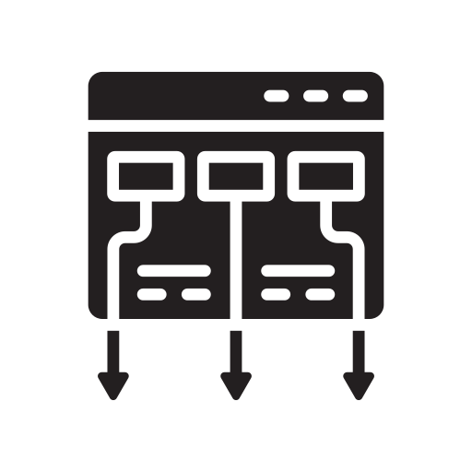












TechM’ s Device Test Automation Framework
Feature Highlights
Test Automation Solution based on Python/Robot Framework
Capable of parallel execution on multiple device/device pairs.
Integrated solution for functional, performance and stability
Supports both Android and iOS automation
Supports cloud-based device farms like BrowserStack
Supports Web/API testing
Supports integration with CI tools like Jenkins, TMS Tools like Test link &Test Rail
Provides detailed reports with screenshots, CPU/Memory utilization
600+ Android platform test scenarios supported
Web UI Dashboard for test, device management
Command line Interface
Desktop Web Automation
Web Dashboard
Jenkins
Web Framework
Platform Library
Config Data
Test Data
Parallel Execution Engine
Selenium Library
Test Functions Library
Test Scripts
Wi-Fi
Robo Framework
Appium Python Client
JSON Wire
Protocol
Appium Library
Reporting & Logging
Appium Server
Test Cases
Bluetooth
Multi-Media Stability Tests
Multi Tasking Stability Tests
Menu Navigation Stability Tests
WiFi/BT Stability Tests
Technology Stack

